Slide 1
Introduction to MapReduce

Slide 2
MapReduce •
Programming model and implementation developed at Google for processing and generating large datasets •
Many real world applications can be expressed in this model
• Parallelism: same computation performed at different cpus on different pieces of input dataset
• Programs are automatically parallelized and executed on large cluster of machines

Slide 3
Motivation
Before MapReduce, Google developers implemented hundreds of special-purpose computations to process large amounts of data
mostly simple computations
• input data so large that it must be distributed across hundreds of thousands of machines
• developers had to figure out how to parallelize computation, distribute data, deal with hardware failures, ...
• MapReduce: abstraction that allows programmers to write simple computations while hiding the details of:
parallelization
data distribution
load balancing
fault tolerance

Slide 4
MapReduce Programming Model
Inspired✣ by the map and reduce primitives of functional programming languages such as Lisp •
map: takes as input a function and a sequence of values and applies the function to each value in the sequence
• reduce: takes as input a sequence of values and combines all values using a binary operator

Slide 5
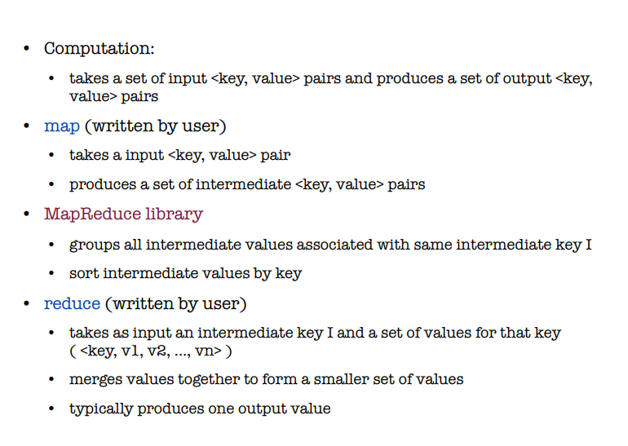

Slide 6
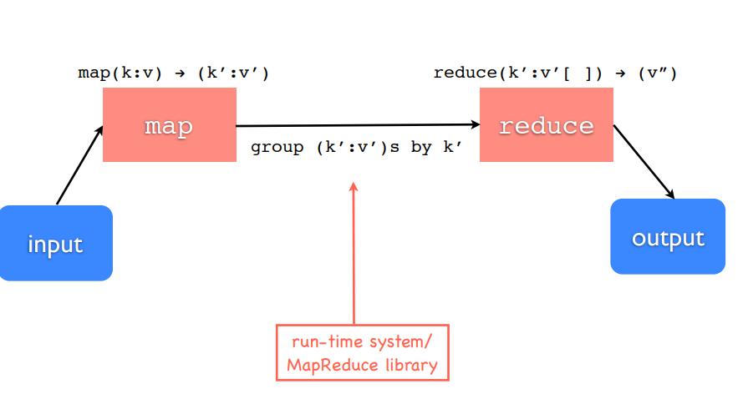

Slide 7
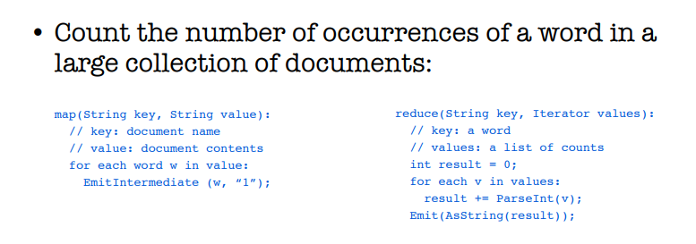
Example:Word Count

Slide 8
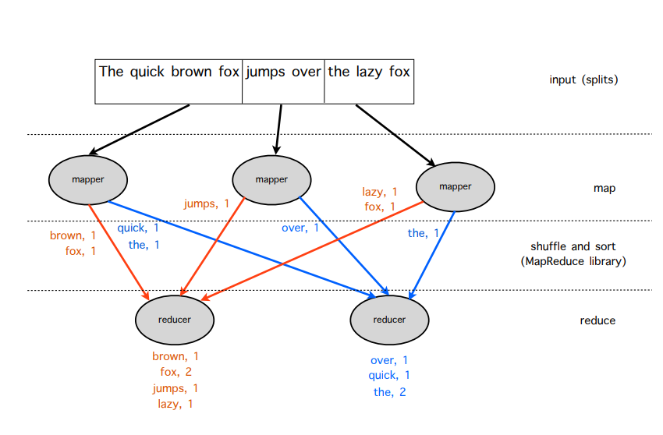

Slide 9
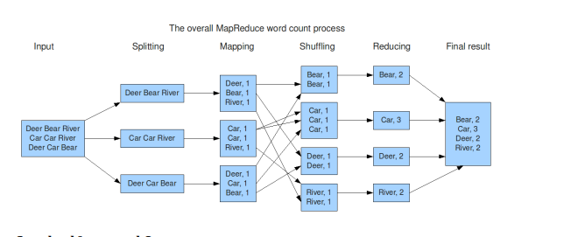

Slide 10
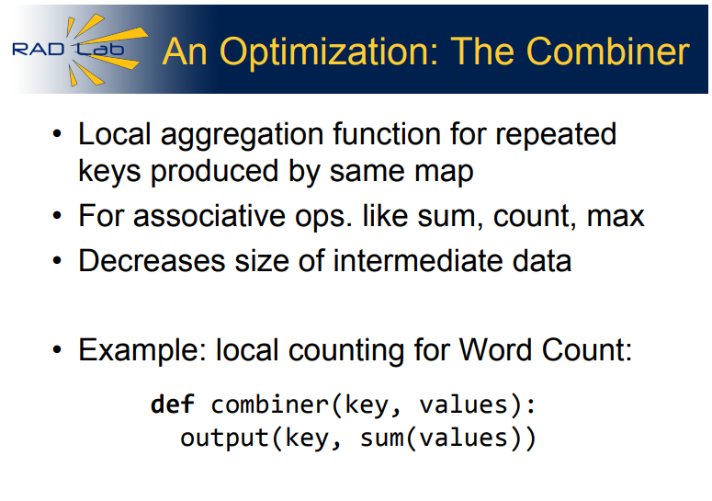

Slide 11
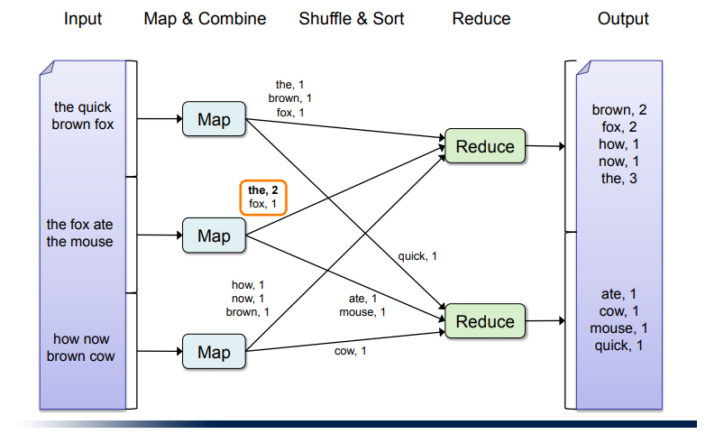

Slide 12
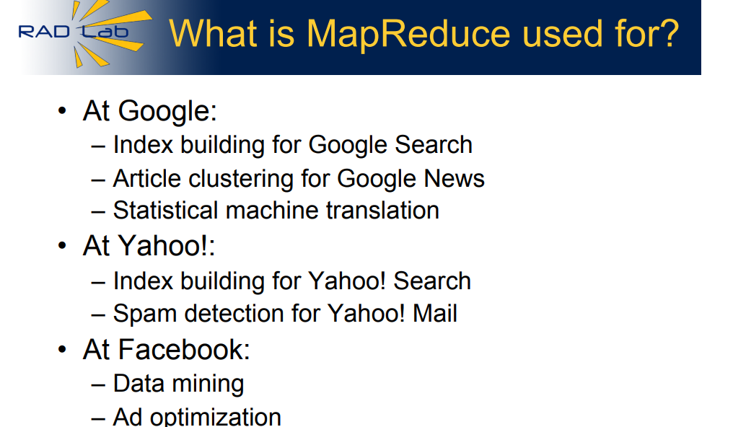

Slide 13
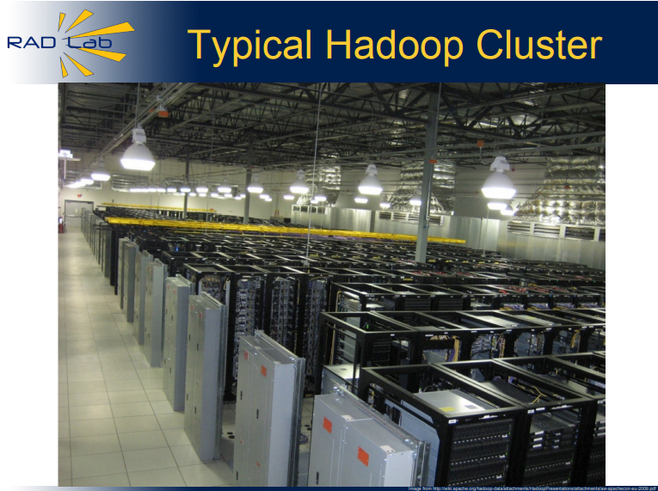

Slide 14
